Slide 1
Amazon WEB Services (AWS)
D&A: Cloud Data Engineering (AWS)

Slide 2

AWS DAY 1 - AGENDA
Cloud computing
AWS
Data and analytics on AWS
Your learning path
Danijel Leoni
Data & Analytics Service Line
Associate Engineer

Slide 3
CONTENT
What will you learn?
Cloud computing
What is cloud computing?
Why cloud computing?
Public cloud providers
AWS
What is AWS?
Overview of AWS Services
AWS Pricing
Your learning path
Lectures overview
Learning outcomes
How will your day look like?
AWS Services: S3, DynamoDB, IAM

Slide 4
CLOUD COMPUTING

Slide 5
CLOUD COMPUTING
What is cloud computing?
“Cloud computing is the on-demand delivery of IT resources over the Internet with pay-as-you-go pricing. Instead of buying, owning, and maintaining physical data centers and servers, you can access technology services, such as computing power, storage, and databases, on an as-needed basis from a cloud provider.” (AWS)
“Simply put, cloud computing is the delivery of computing services—including servers, storage, databases, networking, software, analytics, and intelligence—over the Internet (“the cloud”) to offer faster innovation, flexible resources, and economies of scale. You typically pay only for cloud services you use, helping you lower your operating costs, run your infrastructure more efficiently, and scale as your business needs change.” (Azure)
https://aws.amazon.com/what-is-cloud-computing/

Slide 6







CLOUD COMPUTING
What are the benefits?
Cost
Speed
Productivity
Reliability
Security
Global scale
This Photo by Unknown Author is licensed under CC BY-NC

Slide 7
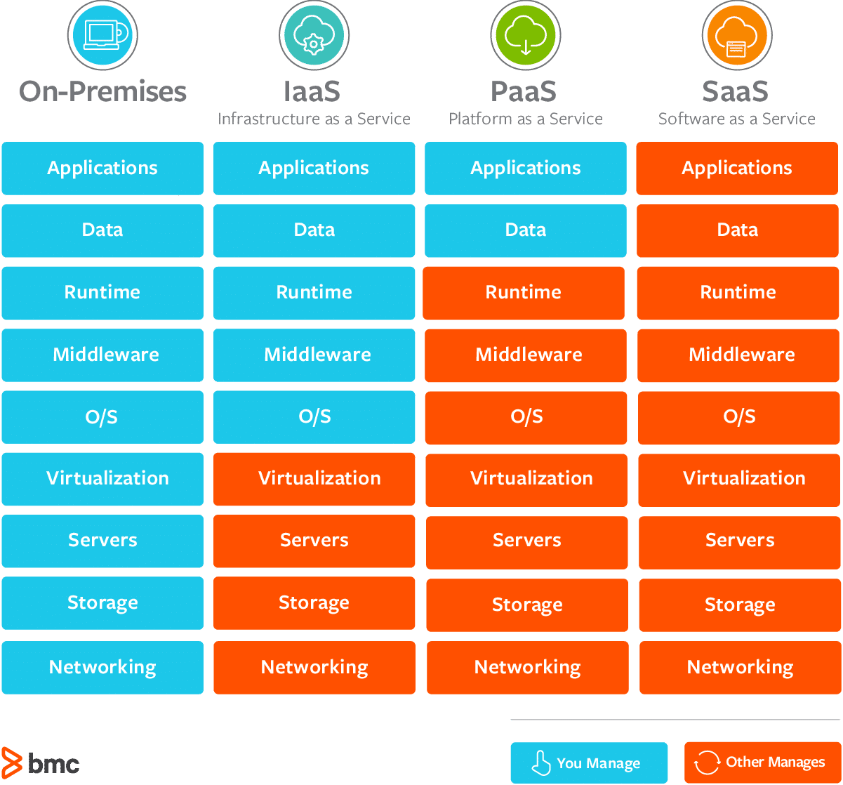
CLOUD COMPUTING
Types of cloud computing
Types of cloud computing
Types of cloud computing services
Private
dedicated to a single end user or group.
underlying IT infrastructure is dedicated to a single customer with completely isolated access.
Public
IT infrastructure not owned by the end user.
Alibaba Cloud, Amazon Web Services (AWS), Google Cloud, IBM Cloud, and Microsoft Azure.
Hybrid
created from multiple environments connected through local area networks, wide area networks, virtual private networks, and/or APIs.
Multiclouds
more than one cloud service, vendor—public or private.

Slide 8
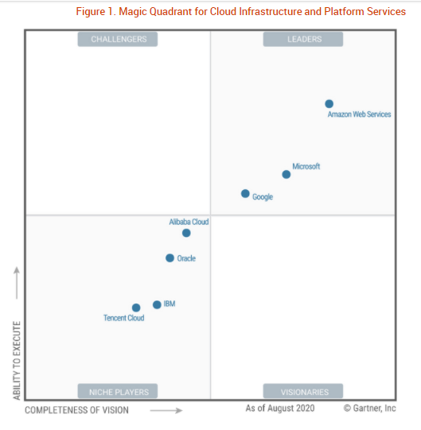
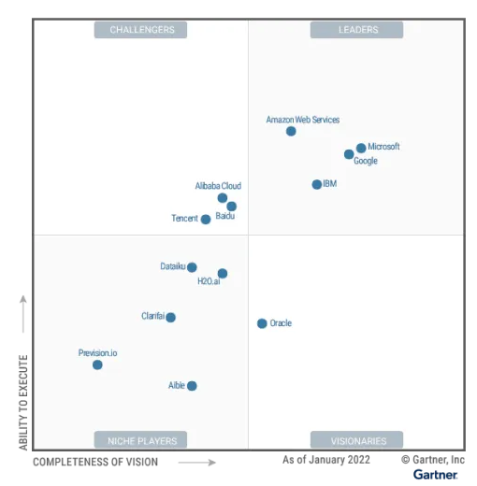
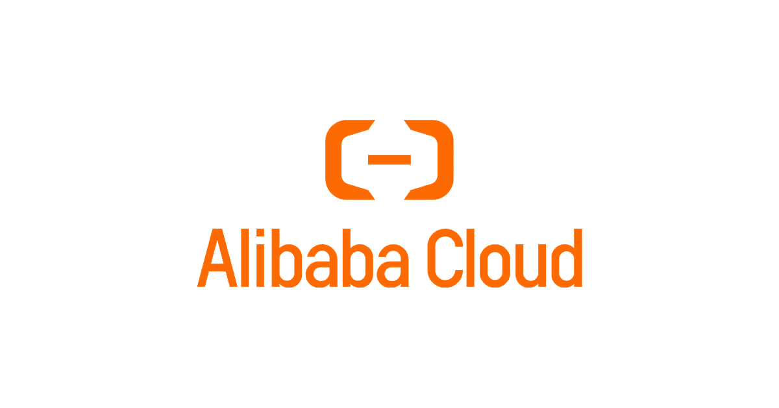

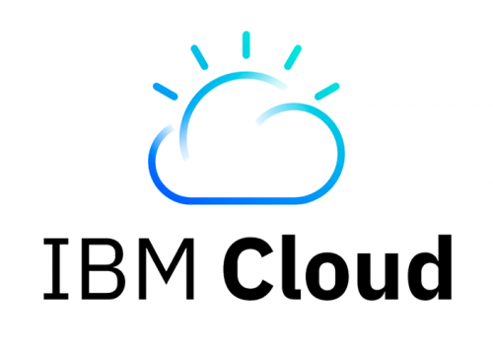
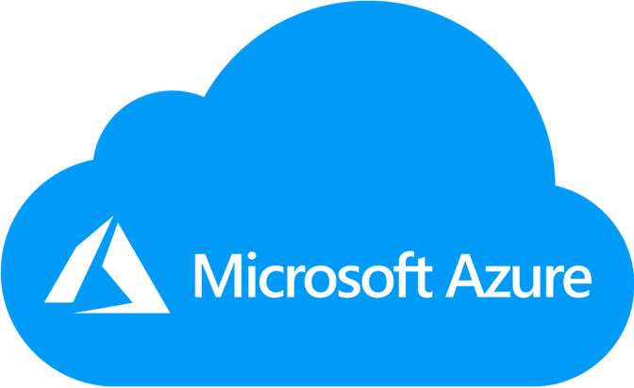
CLOUD COMPUTING
Public cloud providers

Slide 9
Amazon Web Services
(AWS)

Slide 10
Amazon Web Services
What is AWS?
Amazon Web Services (AWS) is the world’s most comprehensive and broadly adopted cloud platform, offering over 200 fully featured services from data centers globally. Millions of customers—including the fastest-growing startups, largest enterprises, and leading government agencies—are using AWS to lower costs, become more agile, and innovate faster.
AWS has more services, and features within those services, than any other cloud provider–from infrastructure technologies like compute, storage, and databases – to emerging technologies, such as machine learning and artificial intelligence, data lakes and analytics, and Internet of Things.
AWS is architected to be the most flexible and secure cloud computing environment available today. AWS supports 90 security standards and compliance certifications, and all 117 AWS services that store customer data offer the ability to encrypt that data.
https://aws.amazon.com/what-is-aws/

Slide 11
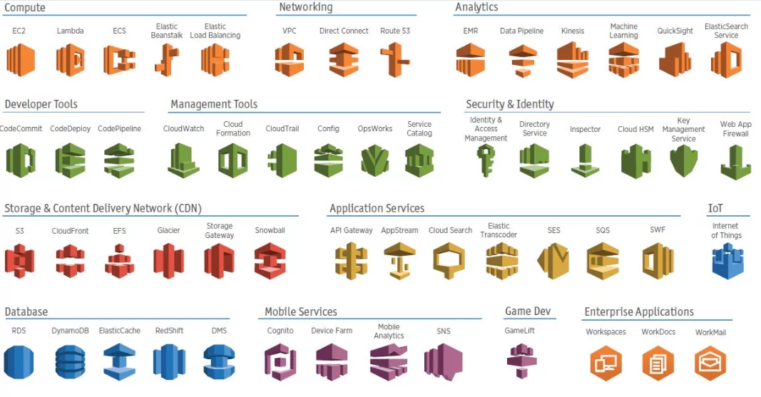
Amazon Web Services
AWS Services

Slide 12

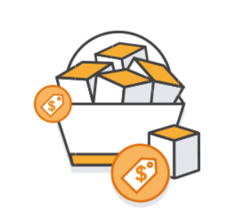
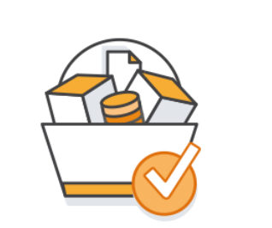
Amazon Web Services
AWS Pricing
You only pay for the services you consume, and once you stop using them, there are no additional costs or termination fees.
Pay-as-you-go
Save when you reserve
Pay less by using more
easily adapt to changing business needs without overcommitting budgets and improving your responsiveness to changes. With a pay-as-you-go model, you can adapt your business depending on need and not on forecasts, reducing the risk of overprovisioning or missing capacity.
With Reserved Instances, you can save up to 75% over equivalent on-demand capacity. When you buy Reserved Instances, the larger the upfront payment, the greater the discount.
Get volume based discounts and realize important savings as your usage increases. For services such as S3, pricing is tiered, meaning the more you use, the less you pay per GB.
https://docs.aws.amazon.com/whitepapers/latest/how-aws-pricing-works/introduction.html

Slide 13
Data and analytics on AWS

Slide 14














Data and analytics on AWs
What we’ll focus on…
Amazon Redshift
Amazon Simple Notification Service (Amazon SNS)
Amazon Simple Queue Service (Amazon SQS)
AWS Step Functions
AWS CloudFormation
Amazon CloudWatch
AWS Identity and Access Management (IAM)
Amazon Simple Storage Service (Amazon S3)
AWS Lambda
AWS Cloud Development Kit (AWS CDK)
AWS CodeCommit
Amazon DynamoDB
AWS Glue
Amazon Athena

Slide 15









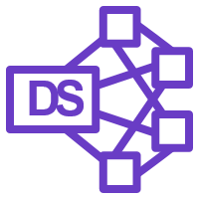









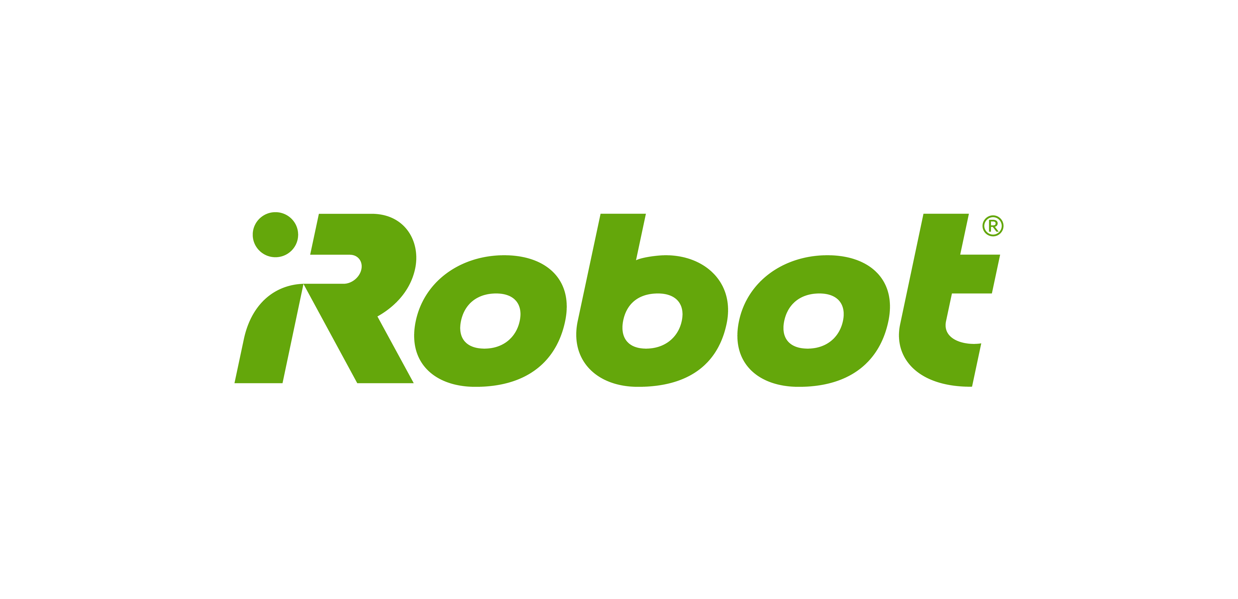
Data and analytics on AWs
Modern data architecture - iRobot
IOT Raw Data Ingestion
External Sources
Robot
IOT Rule
Firehose
Raw Data
S3 Copy
CRM
APIs
User Behavior
L1 Processed Data
L2 Processed Data
Reporting Layer
Raw Data
Data Processing
Firehose
L1 Processed
Redshift Load
Redshift
Tableau Server
Business Users
10 Million Robots
Processing EMR
L2 Processed
Athena
9TB Per Day
API
Support Agents
Under 8 seconds
Redis

Slide 16
Your learning path

Slide 17
Your learning path
Lectures overview
Day 1
Cloud Computing
Amazon S3
AWS IAM
AWS DynamoDB
Day 2
AWS Lambda
AWS SNS
Day 3
AWS Step Functions
AWS SQS
Day 4
AWS Glue

Slide 18
Your learning path
Lectures overview
Day 5
Amazon Redshift
Amazon Athena
Day 6
AWS IAM
S3
DynamoDB
Day 7
Day 8
AWS Step Functions
AWS Lambda
AWS SNS

Slide 19
Your learning path
Lectures overview
Day 9
CloudFormation
AWS Glue
Day 10
AWS CDK Intro
Day 11
AWS CDK

Slide 20
Your learning path
How will your day look like?
Daily overview
Discussion
Theoretical lectures
Individual work
Practical tasks
Documentation and LMS Courses
Submission
Preparation of technical documentation
Submission

Slide 21
Amazon S3

Slide 22
Amazon Simple Storage Service (Amazon S3)
Use cases
Backup and restore
Scalable, durable, and secure backup and restore solutions with Amazon S3 and other AWS services, such as S3 Glacier, Amazon EFS, and Amazon EBS, to augment or replace existing on-premises capabilities.
Disaster recovery
With Amazon S3 storage, S3 Cross-Region Replication, and other AWS compute, networking, and database services, you can create DR architectures in order to quickly and easily recover from outages caused by natural disasters, system failures, and human errors.
Archive
Retire physical infrastructure, and archive data with S3 Glacier and S3 Glacier Deep Archive. These S3 Storage Classes retain objects long-term at the lowest rates. Simply create an S3 Lifecycle policy to archive objects throughout their lifecycles, or upload objects directly to the archival storage classes. With S3 Object Lock, you can apply retention dates to objects to protect them from deletions and meet compliance requirements.
Data Lakes and big data analytics
Accelerate innovation by building a data-lake and extract valuable insights using query-in-place, analytics, and machine learning tools.
Cloud-native applications
With Amazon S3, you can upload any amount of data and access it anywhere in order to deploy applications faster and reach more end users.

Slide 23
Amazon Simple Storage Service (Amazon S3)
Why S3?
Manage data and access controls
Query-in-place and process on-request
Most supported cloud storage service
S3 gives you robust capabilities to manage access, cost, replication, and data protection.
Use Amazon Athena to query S3 data with standard SQL expressions and Amazon Redshift Spectrum to analyze data that is stored across your AWS data warehouses and S3 resources.
Store and protect your data in Amazon S3 by working with a partner from the AWS Partner Network (APN) — the largest community of technology and consulting cloud services providers.

Slide 24
Amazon dynamodb

Slide 25
Amazon dynamodb
What is Amazon DynamoDB?
Amazon DynamoDB is a key-value and document database that delivers single-digit millisecond performance at any scale. It's a fully managed, multi-region, multi-active, durable database with built-in security, backup and restore, and in-memory caching for internet-scale applications. DynamoDB can handle more than 10 trillion requests per day and can support peaks of more than 20 million requests per second.
https://aws.amazon.com/dynamodb/
Amazon DynamoDB

Slide 26
Amazon Dynamodb
Why Amazon DynamoDB?
Performance at scale
No servers to manage
Enterprise ready
DynamoDB supports some of the world’s largest scale applications by providing consistent, single-digit millisecond response times at any scale.
DynamoDB is serverless
DynamoDB automatically scales tables up and down
Availability and fault tolerance are built in.
DynamoDB provides both provisioned and on-demand capacity modes
DynamoDB encrypts all data by default and provides fine-grained identity and access control on all your tables.
You also can export your DynamoDB table data to your data lake in Amazon S3 to perform analytics at any scale.

Slide 27
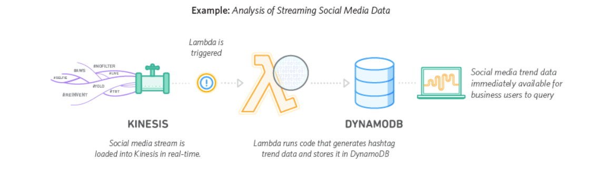
Amazon Dynamodb
Architecture example
https://aws.amazon.com/dynamodb/

Slide 28
AWS Identity and Access Management (IAM)

Slide 29
AWS IAM
What is AWS IAM?
“AWS Identity and Access Management (IAM) enables you to manage access to AWS services and resources securely. Using IAM, you can create and manage AWS users and groups, and use permissions to allow and deny their access to AWS resources.”
“IAM is a feature of your AWS account offered at no additional charge. You will be charged only for use of other AWS services by your users.”
https://aws.amazon.com/iam/
AWS Identity and Access Management (IAM)

Slide 30
AWS IAM
Use cases
Fine-grained access control to AWS resources
IAM enables your users to control access to AWS service APIs and to specific resources. IAM also enables you to add specific conditions such as time of day to control how a user can use AWS, their originating IP address, whether they are using SSL, or whether they have authenticated with a multi-factor authentication device.
Multi-factor authentication for highly privileged users
Protect your AWS environment by using AWS MFA, a security feature available at no extra cost that augments user name and password credentials. MFA requires users to prove physical possession of a hardware MFA token or MFA-enabled mobile device by providing a valid MFA code.
Analyze access
IAM helps you analyze access across your AWS environment. Your security teams and administrators can quickly validate that your policies only provide the intended public and cross-account access to your resources. You can also easily identify and refine your policies to allow access to only the services being used. This helps you to better adhere to the principle of least privilege.
Integrate with your corporate directory
IAM can be used to grant your employees and applications federated access to the AWS Management Console and AWS service APIs, using your existing identity systems such as Microsoft Active Directory. You can use any identity management solution that supports SAML 2.0, or feel free to use one of our federation samples (AWS Console SSO or API federation).

